Slide 1
Future finance masterclass

Slide 2
Session two:
The CFO's blueprint for fixing broken processes

Slide 3
Future finance masterclass
Workshop dates
25 October 14:30 BST/9:30 am EDT
Why your finance team is leaving and what you can do to stop it
People
15 November 14:30 GMT/9:30 am EST
The CFO's blueprint for fixing broken processes
Process
Systems
6 December 14:30 GMT/9:30 am EST
Essential tools your finance team needs in 2023

Slide 4
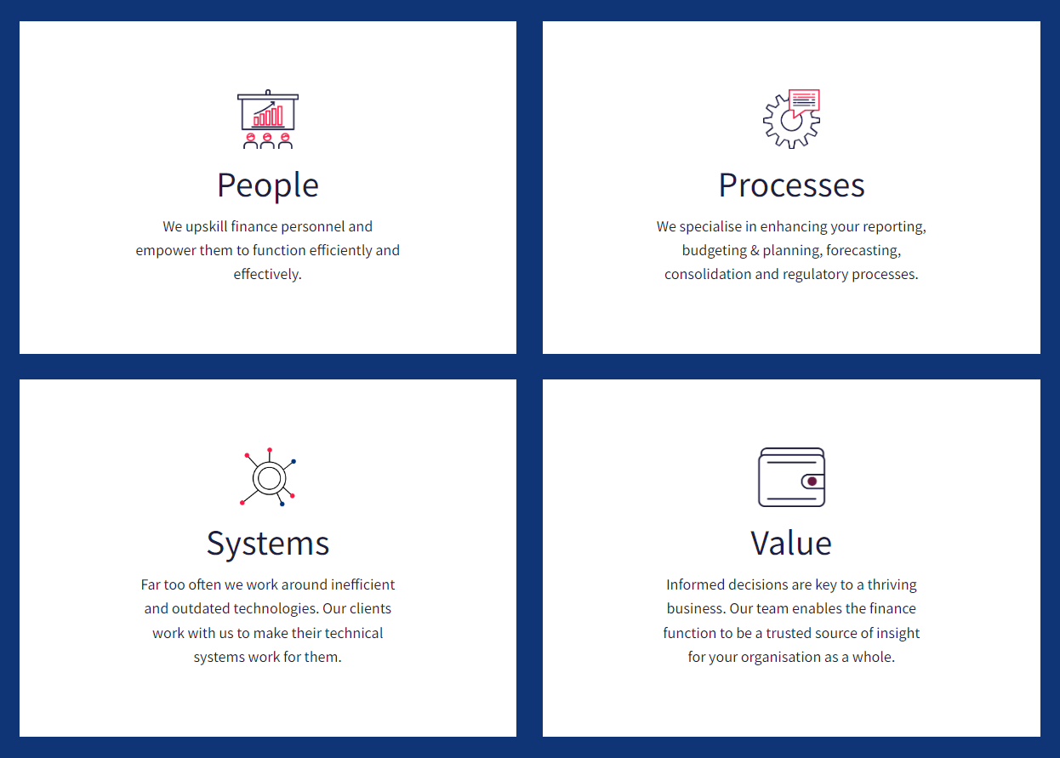
Future finance masterclass

Slide 5



Our panel
Ian McKenzie
CFO
John Fuggles Partnership Manager
Phil Heu-Weller Finance Transformation Leader

Slide 6
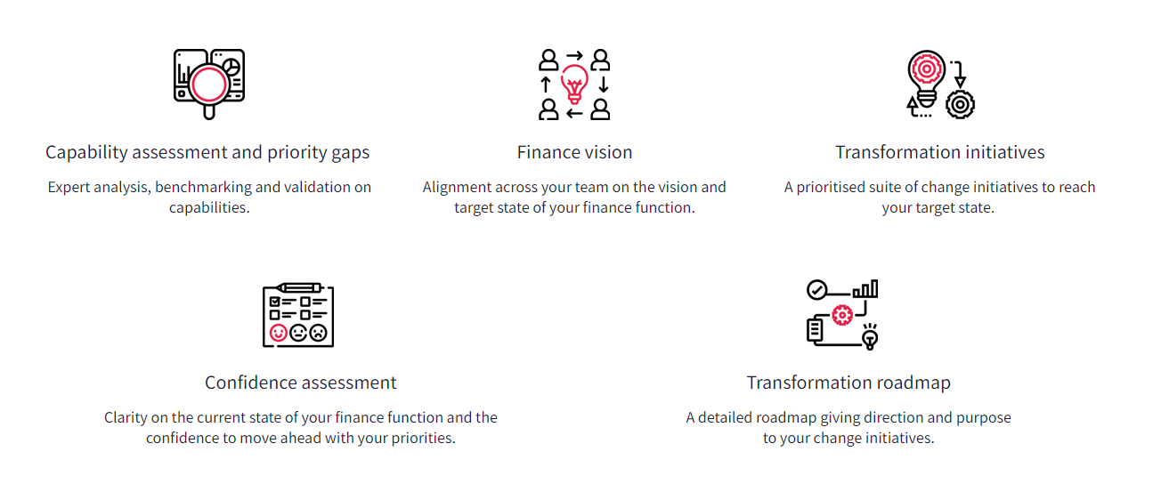
CFO Labs by VantagePoint
Elevate your finance function by creating a connected finance strategy in one day

Slide 7
Q&A

Slide 8
The CFO's blueprint for fixing broken processes
Phil Heu-Weller - Finance Transformation Leader

Slide 9
Finance transformation for the CFO
6 steps to start the transformation journey
Future-proofing
Cost/benefit evaluation
Gap analysis
Vision-casting
Benchmark
Discovery
Notes:
Discovery: what have you inherited? Why is it done this way? When/Has anyone looked at this?
How does today stack up against standards/peers/expectations?
What is the future vision? Is today an enabler or an obstacle?
What is the gap we have to bridge? How will we get there?
What is the cost – hours, financial, damage, customers – Is it worth it?
How do I make it so that it’s flexible (futureproof) even after we’ve delivered what we need?
But at each step, be aware of what next, and make the transition/progress easier
Always be conscious of the overall objective
Think beyond of the Office of Finance and within the Office of Finance
The team and the function
The department
Other departments
The company as a whole
The individuals

Slide 10
Finance transformation for the CFO
Key questions to answer
PEOPLE • PROCESS • SYSTEMS
What needs to change?
How did we get here?
Is the gap increasing? How urgent is it?
What is my burden of debt?
What other costs do I need to consider?
How do I take my team and business with me?
Notes:
What has changed? What needs to change? Why is it not happening?
How do I take the team with me? Are they enablers or blockers to change?
What is my debt burden? data, systems, processes, people
Is the gap getting bigger or has it always been there?
Is the cost of doing it more than the company and team can/will bear?
How do I take my team and the business with me?
How did we get here? Root cause
What needs to change?
HOW urgent and how material?
What is my burden of debt? Will this be adopted?
What other costs do I need to consider?
How do I take my team with me?

Slide 11
Key Takeaways
Ian’s top tips
Phil’s top tips
Measure twice, cut once
Anticipate speed bumps
Carry people on the journey
Progress over perfection
Technology alone is
not the answer
Transformation leadership
Notes:
1: “Measure twice, cut once” – develop clear objectives to the transformation with your stakeholders so that you can achieve measurable success.
2: “Carry people on the journey” – become an advocate for the change from the moment that you know change is needed; develop a buzz around the work needed; over communicate.
3: “Transformation is no panacea” – digitising a broken process may speed it up but it still won’t be efficient; always ensure that you have considered whether the principle process actually works.
1: "Anticipate roadblocks" - every process transformation will encounter challenges.
2: "Progress over perfection" - Pareto principle applies
3: "Transformation leadership" - successful process change requires vision, operational execution, and perhaps most importantly, consistent, steady leadership. Leadership over mgmt

